Slide 1

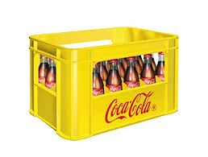
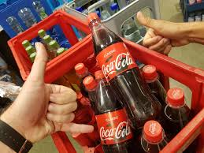

Returnables/ Refillables are a powerful tool to drive Category Leadership
Category Expansion!
  Footprint: Incidence & Frequency
  Affordability, Premiumness
  Loyalty
  Space: SOVI & Pantry
Sustainability
A one-of-a kind WIN-WIN-WIN-WIN System Proposition - WIN⁴
EUROPE
RGM IGNITE SESSION

Slide 2
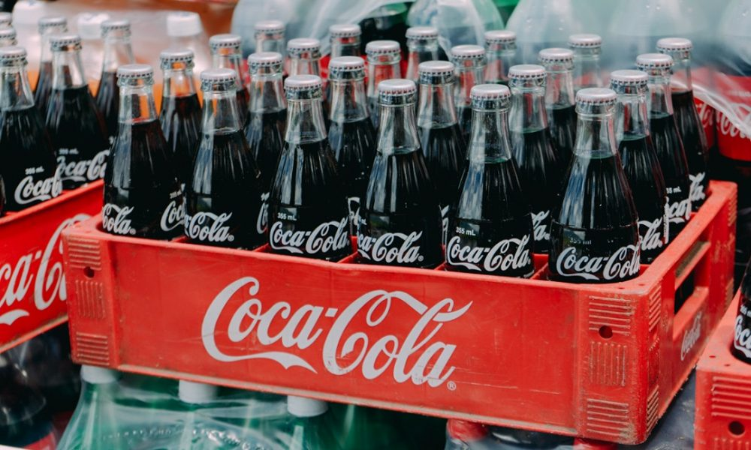
The business imperative
The returnables platform is a key enabler for accelerated incidence and share growth while delivering our zero-waste goals.

Slide 3
Returnables play a strategic Role in our Business
COMPETITIVE ADVANTAGE
Protect our Base
CONSUMER PERCEPTION
Affordable and Competitive Price Points
Levers Habit and improves Frequency of Consumption
Key to consumer loyalty, as packages serve as a constant purchase reminder
Glass bottles with a premium role
CATEGORY EXPANSION
In periods of crisis, Returnables were more consistent as consumers are more loyal
Enables OBPPC Strategy Differentiating Packages – One Way
Returnables are key to PoS loyalty as an important tool to increase frequency
SUSTAINABILITY
Reutilize – World Without Waste
14.1%
Of our global portfolio is in returnable packages
In 40+
markets, returnables account for 25% or more of sales
In 20
markets, returnables account for 50% or more of sales

Slide 4



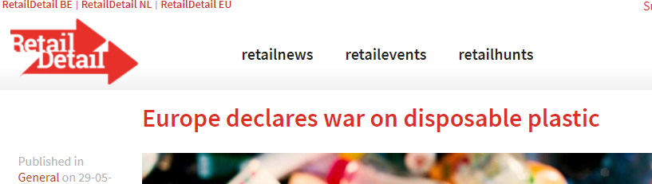
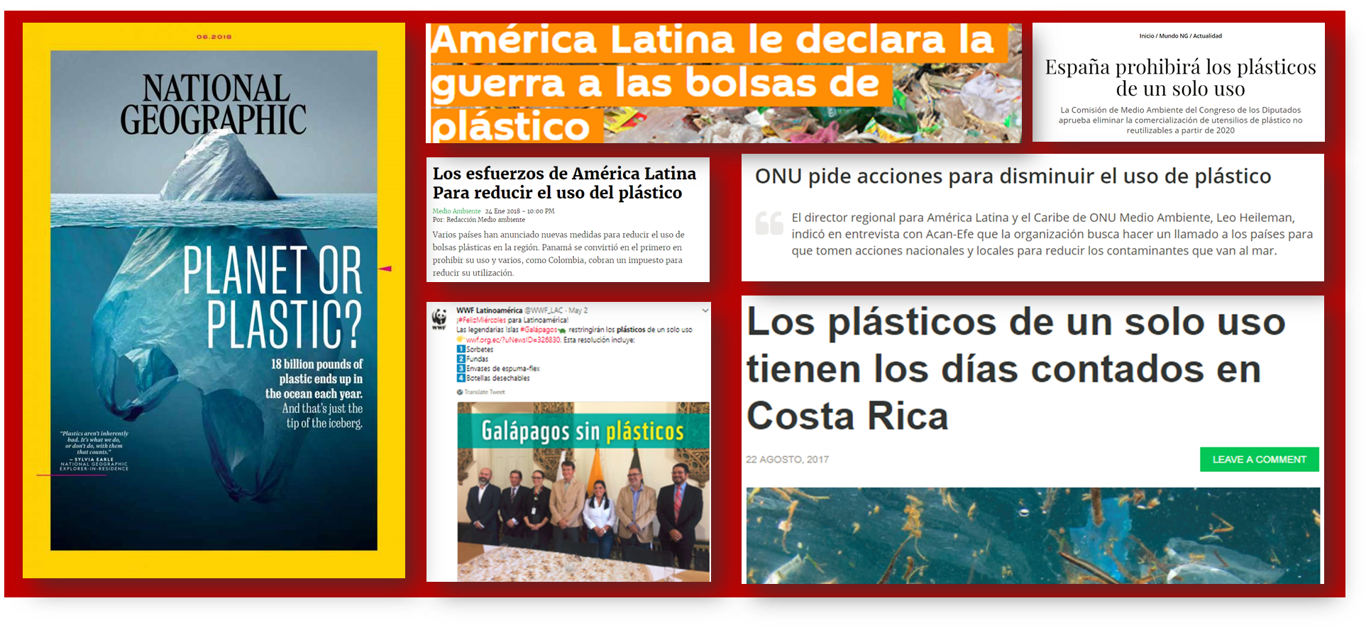
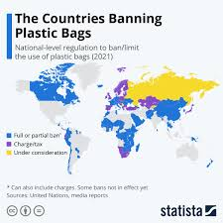

Furthermore, there are other key drivers,
making Returnability even more relevant facing the future of our business!
Taxes
Regulation
Prohibitions
Consumer trends
“Latin America declares war on plastic bags”
“Single-use plastics have the days counted in Costa Rica”

Slide 5
Where Returnables are a good choice

Slide 6

Yes…
…Returnables should be a Key Business Growth Pillar for our System…
…so, what should we do about it?

Slide 7
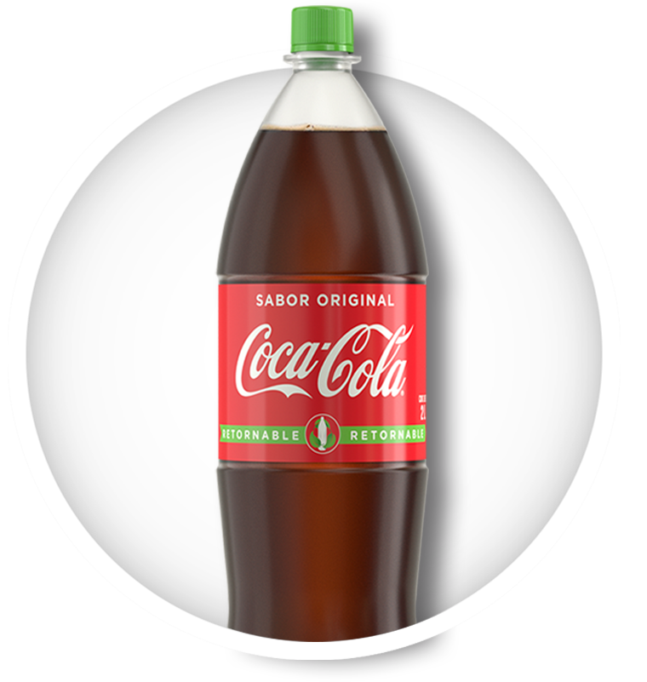
What is the mix of Returnable in each OU?
Returnables Volume Mix

Slide 8
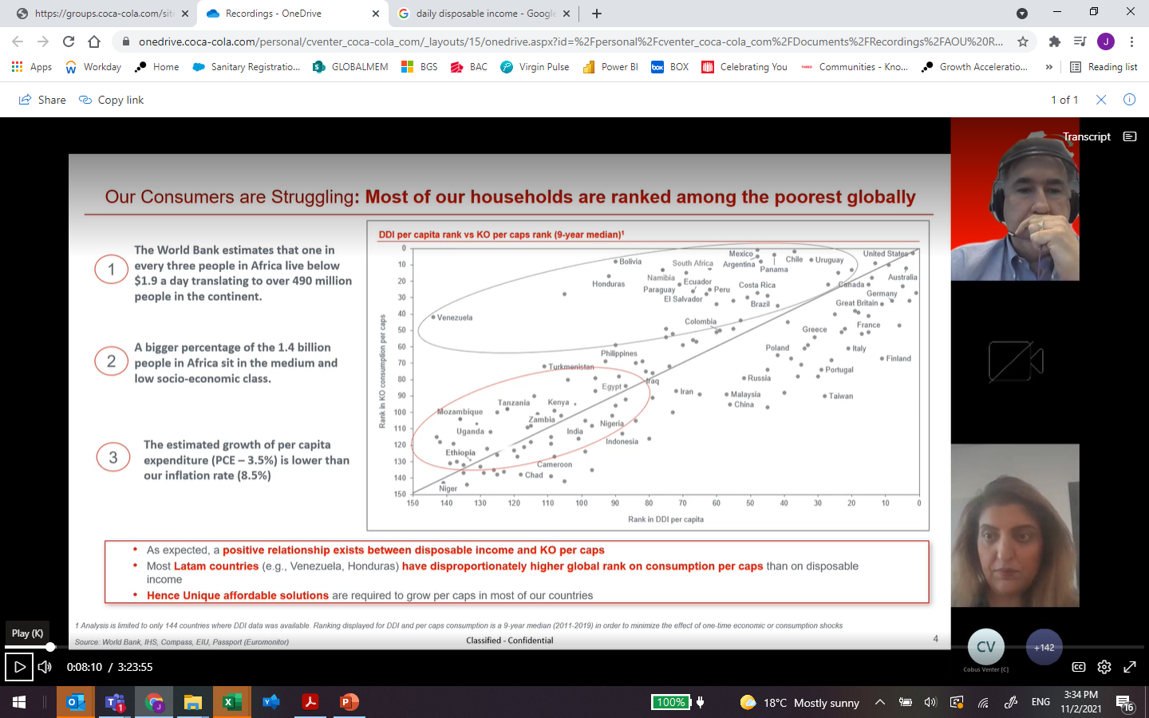
Relationship between Disposable income and KO Percaps

Slide 9
Returnables have been one of the main growth drivers of the system, supporting KO to overcome recent crisis
Continuing to grow in Crisis
Returnables MS
Latam Volume
1.44 X
CAGR 3.7%
2020
9%
2021 YTD
7%

Slide 10


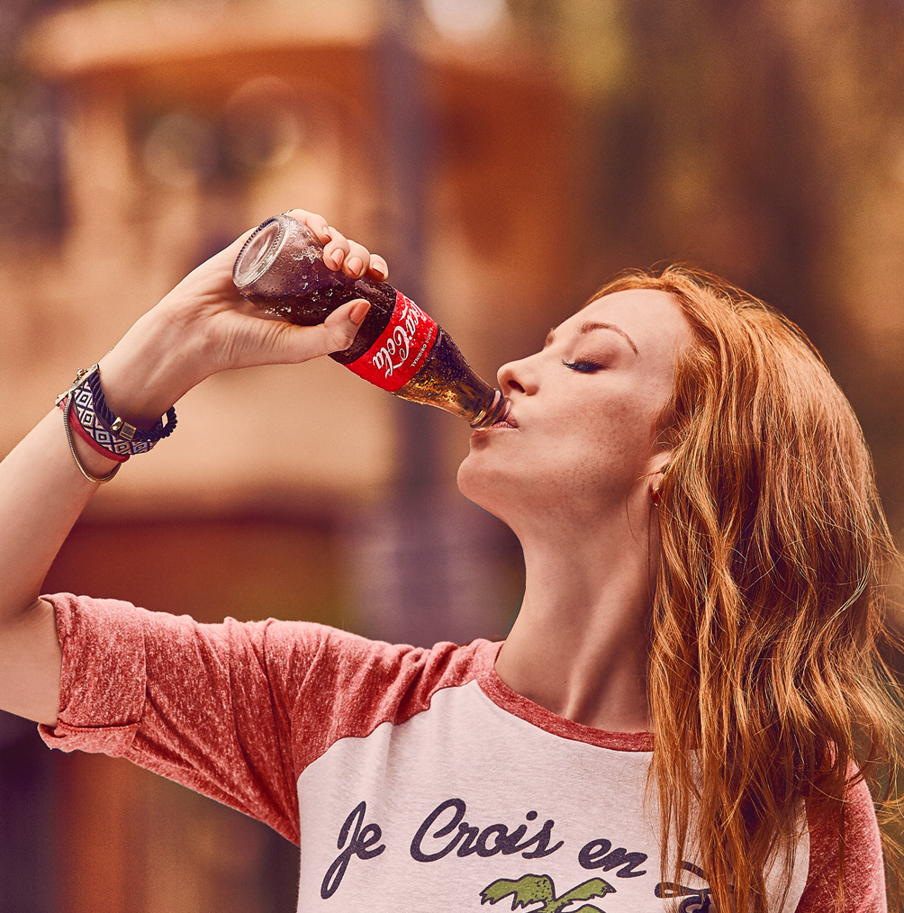

We should focus on our consumer Drivers
to turn them into our Returnability Edge
Powered by the brands´ Equity
Returnables’ EDGE
Affordability
Smart shopper
Best consumption experience
Better for the environment
“Iconic” experience
Relevance
Uniqueness
Returnables Edge is not only about the bottle
…but about the whole value proposition, powered by the Brand’s attributes and Equity, which makes it appealing and relevant to consumers.

Slide 11



Contributing in all relevant dimensions
in our 3 A’s model
Availability
Affordability
Affinity
Cold and ready to enjoy (drinking experience)
Competitive price
Best value equation
Smart shopper
Environmental care
Frequency enabler
Returnability!

Slide 12





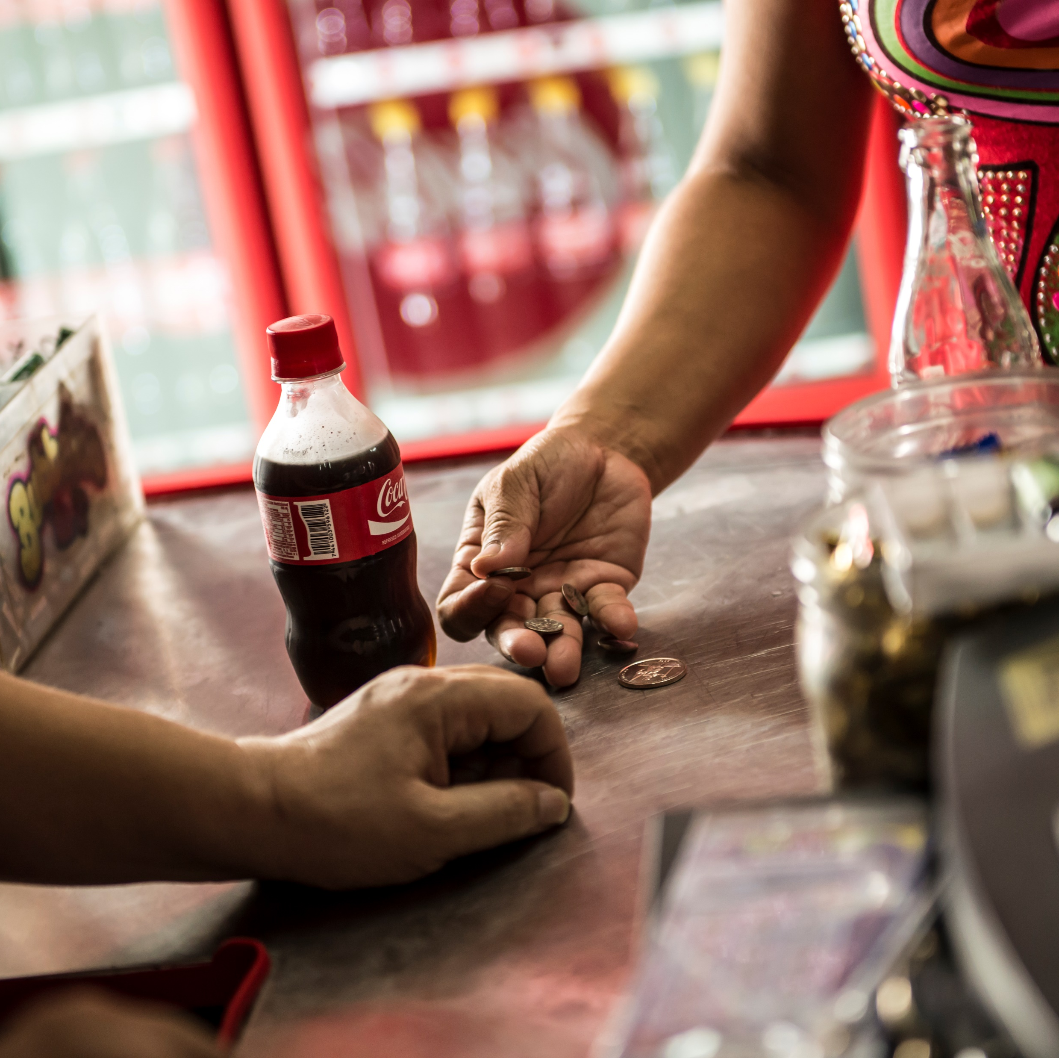
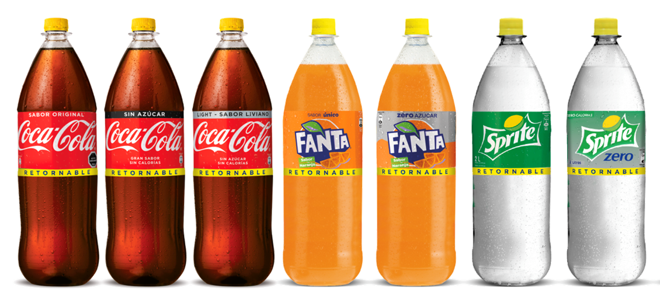




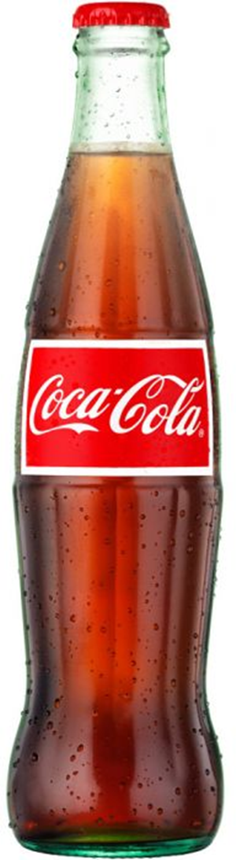
as a Subscription Model
Leveraging Returnability
It’s a Subscription Economy!
Customers
+
Recurring revenue flow
Consumers
Returnable bottle as the enabler or “access key” to our portfolio.

Slide 13





The Returnability virtuous cycle…
Winning
Portfolio
Holistic OBPPC (affordability + value)
Universal bottle
Full Engagement
Profitable
Consumer Base
Growth
Outstanding
Experience
BuilD & reinforce the returnable habit through fully integrated 360 Plans for all stakeholders
State of the art Execution
Appealing and call to action Communication
Consumer
Enablers, Processes, KPI´s & Continuous investment

Slide 14
Holistic OBPPC
Universal bottle
Winning
Portfolio

Slide 15

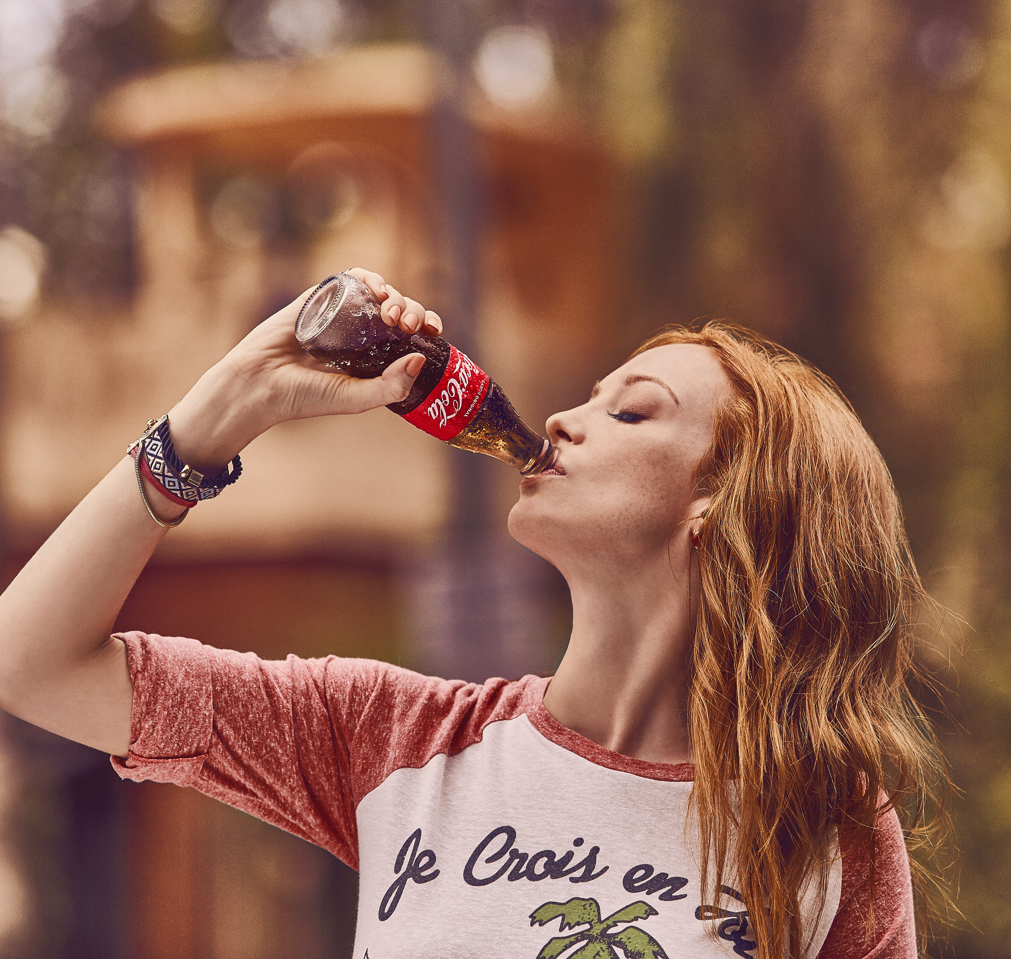
Returnables play a strategic role
in our Portfolio and Business
Returnables are the vehicle to ensure affordability and allow us to connect with low SEL
OBPPC strategy with a clear Returnables roles boost habit development by reaching more consumer & shopper needs
Segmented returnables allows to Maximize Revenue generation with one way packages
Glass Bottles with a premium role in IC Channels and at Home.

Slide 16

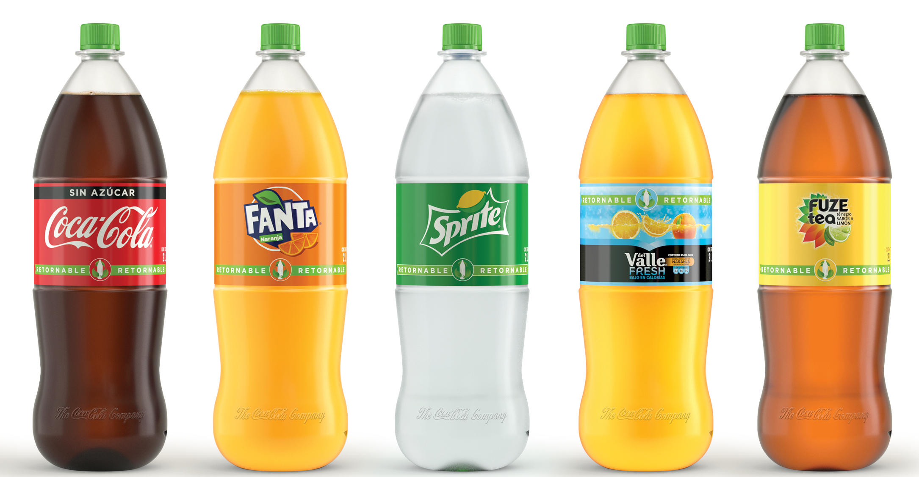
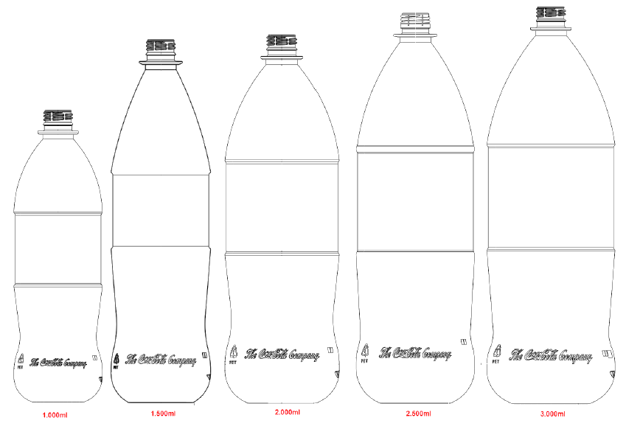
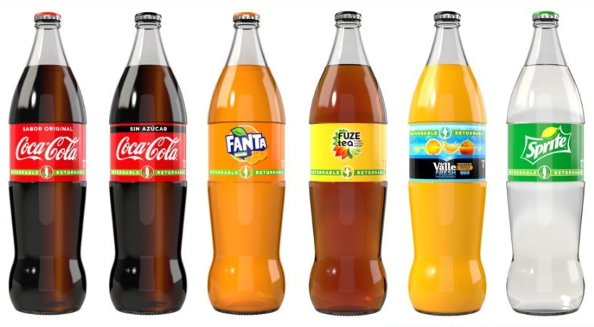
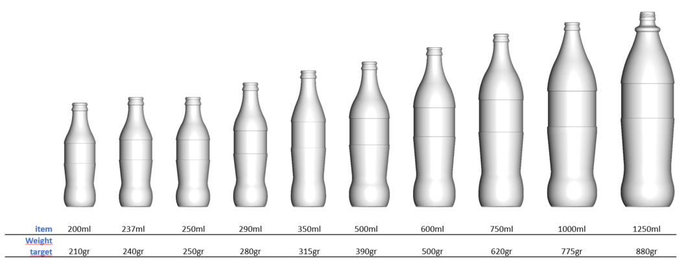
A new Returnable Bottle Family
Is ready to deploy
  Ref Pet MS Universal Bottle
Contour without flutes
Fully Compatible with current fleet.
Lightweight 2L @ 91gr
KO Proprietary Technology (cost reduction)
  RGB SS Universal Bottle
Cylindrical Panel with 3 contact points
Reduced scuffing
Aggressive lightweight
Enables labeling

Slide 17
State of the art Execution
Appealing and call to action Communication
Outstanding
Experience

Slide 18

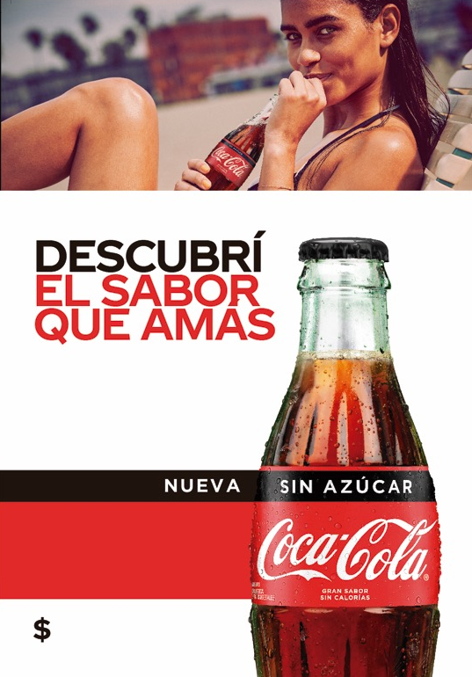
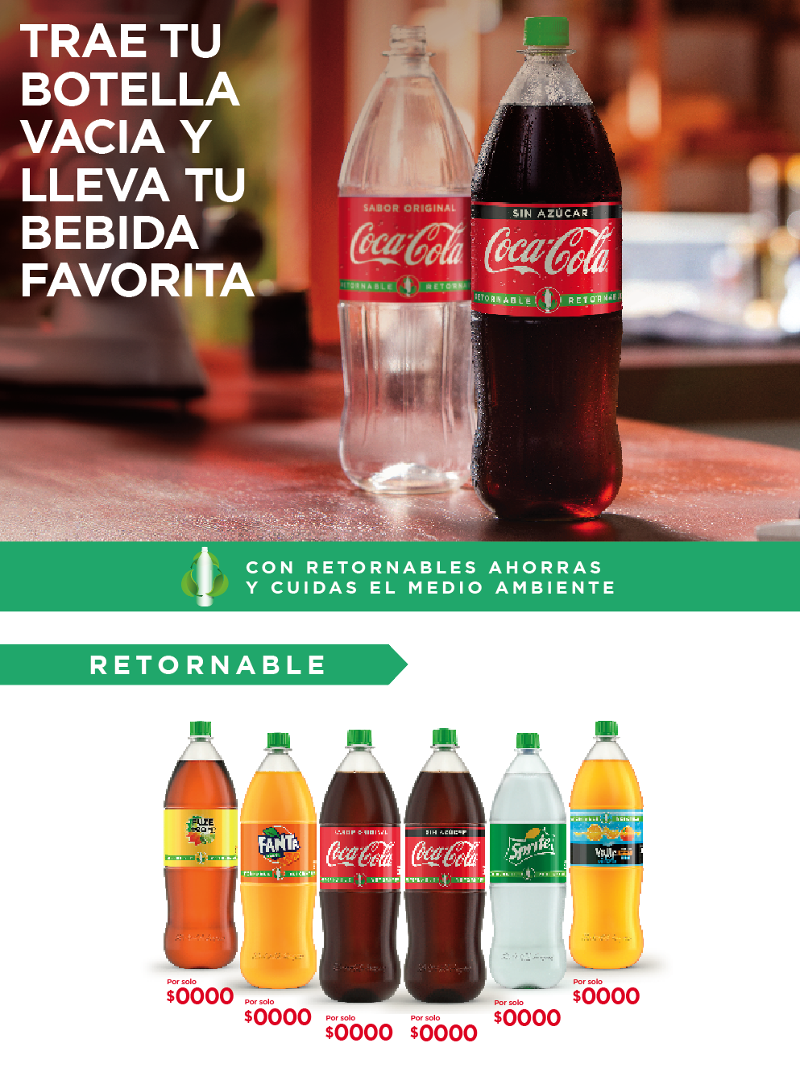

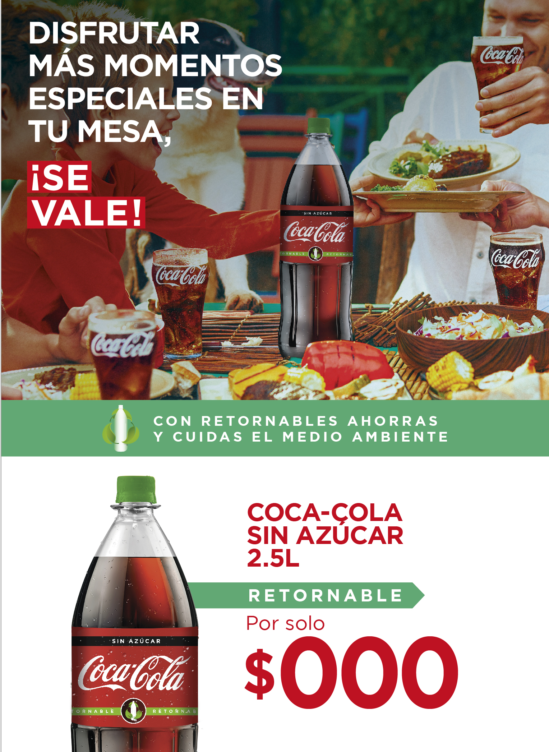
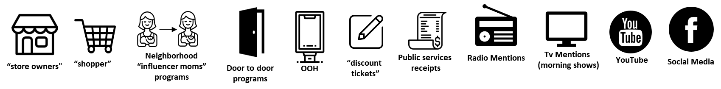

Engaging consumer through
proper connection strategy
SS consumption
Build Habit
Penetration
Frequency
With the right
Messages
…and Right
Connection Points and moments

Slide 19
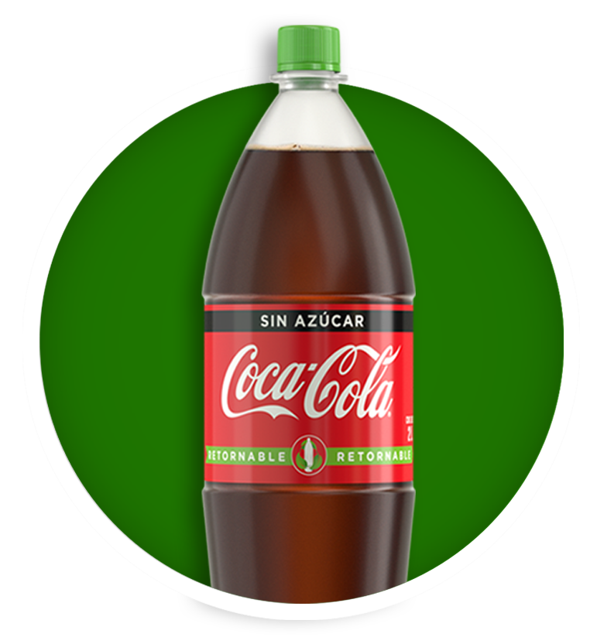
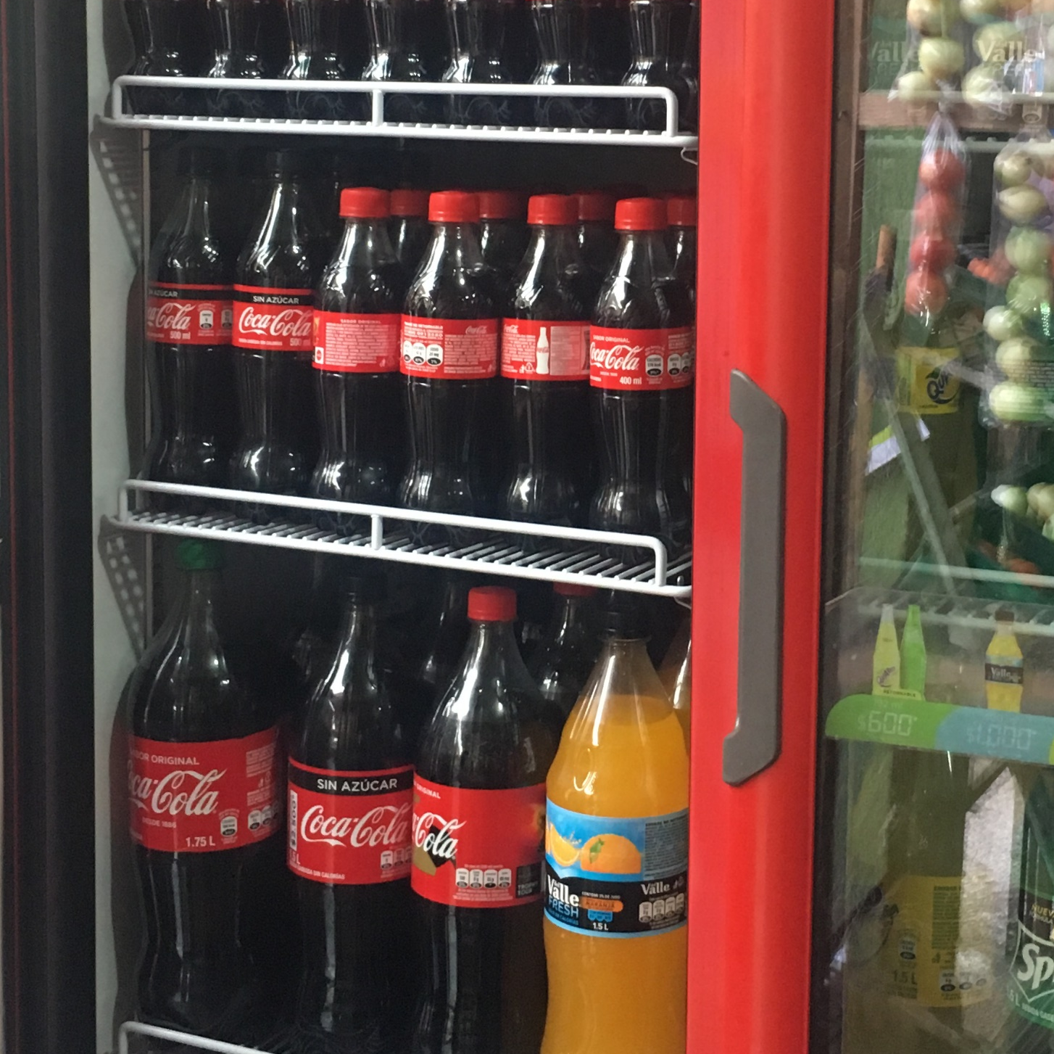


…will generate Returnable’s Execution EDGE
& improve our Quality Leadership
Availability
Improve profit - margins
Sales - Transactions
SOVI & SOCI
Returnables’ EDGE
Volume
Revenue
Profit
Share of Market
Share of Value
CDE/10k hab
Items per store
Increase consumer base
Relevance
POS Experience
ReturnablesPortfolio Availability
Cooler Coverage and Execution
Brand love
Dailies conversion
Per Caps increase
Better experience
Uniqueness

Slide 20
Build & reinforce the returnable habit through fully integrated 360 Plans for all stakeholders
Full
Engagement

Slide 21
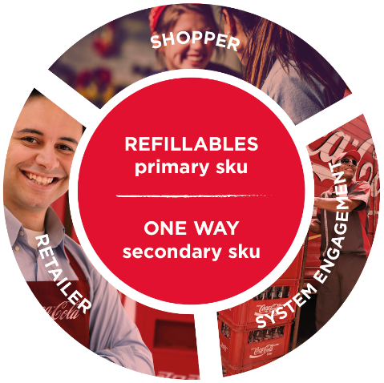
Engaging all players through
a full 360° returnable and affordability plan
Shoppers
Outstanding Communication and Promotional Platform for RET PicOS at POS
Retailers
Introducing a 4-tier plan:
Retailer Incentives
Loyalty programs
Visibility Drive
Training
360º
System Engagement
Motivating Sales & Distribution Teams
Sales force incentives
Distribution awards
Training
Tools
Trade MKT
Increase Transactions
Increase Profit

Slide 22
THANK YOU.

